Slide 1
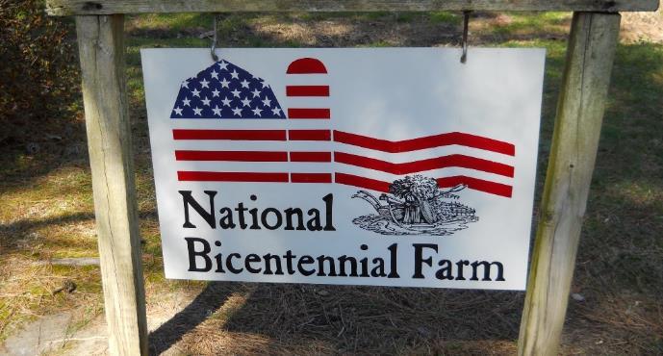
Cotton Weed Management - 2020
Herbicide updates (Dicamba, Valor, Tavium)
Weed management program
Plant bugs
Grass control
Spiderwort control
PPO resistance update
Glyphosate…is it safe for us to use?

Slide 2
Annual Dicamba Stewarship Training
2020 Using Pesticides Wisely
UGA/GDA have submitted label to allow for training every other year?
U.S. EPA is considering our proposal.
UPW meetings will be in March.

Slide 3

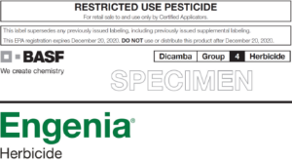
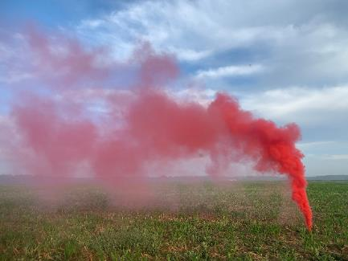
Dicamba 2020 Labels
same as 2019
Pesticide license required
2 applications in cotton; complete within 60 d of planting
Application 1 hr after sunrise – 2 hr of sunset
“Do not apply when wind is blowing in the direction of neighboring downwind sensitive crops.”
Avoid inversions, winds 3-10 mph
Be smart, these products are volatile

Slide 4

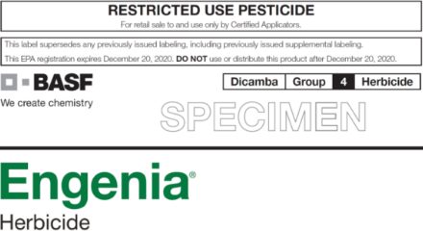
Will there be 2021 labels that are usable in our cotton?
FILL OUT SURVEY IF YOU WANT INPUT!

Slide 5
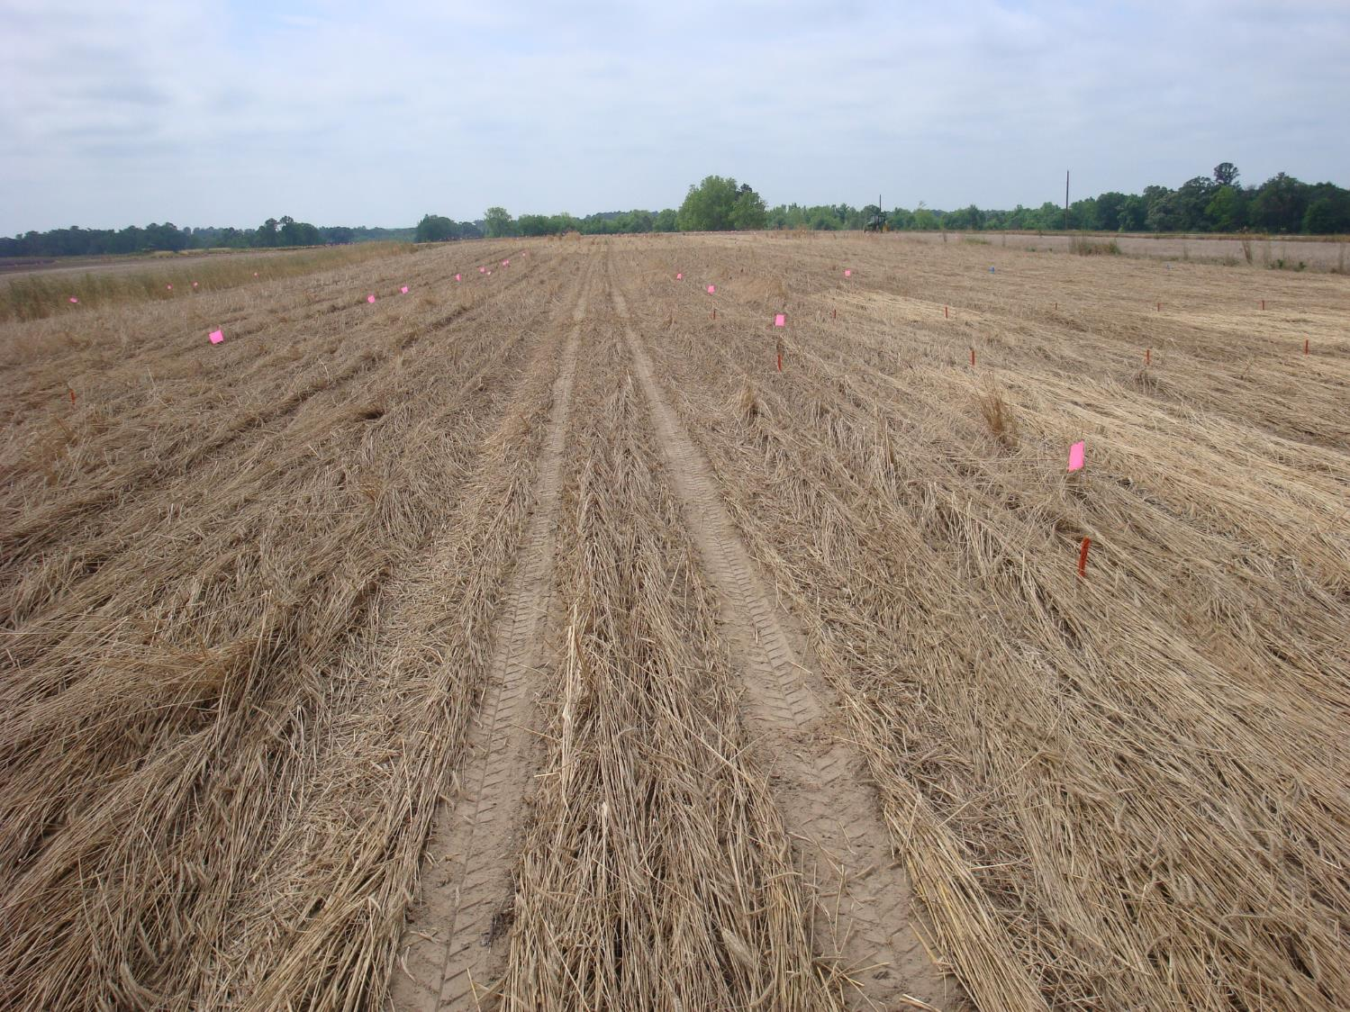
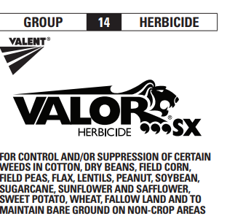
Updating State Labels - Burndown

Slide 6
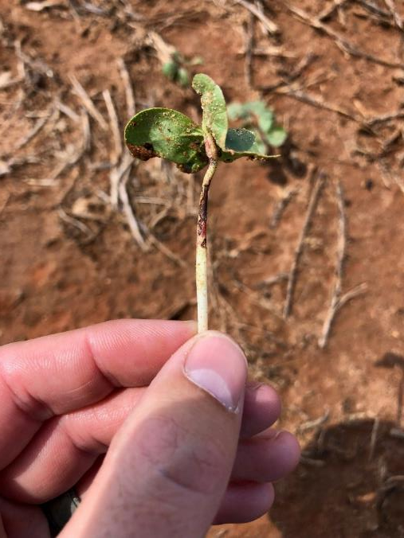
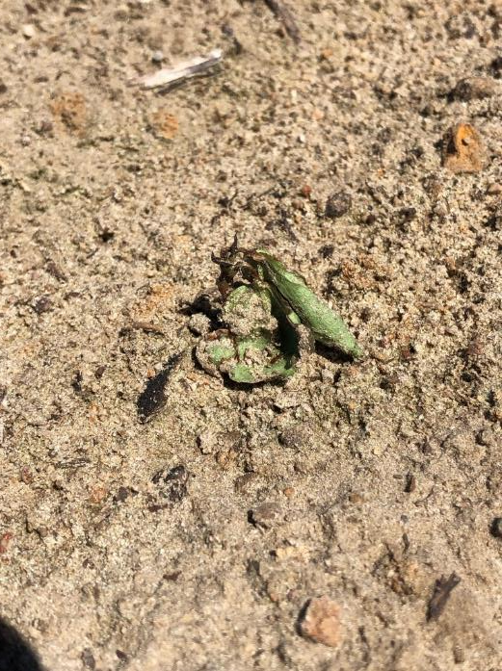
Updating State Labels - Burndown

Slide 7
Updating State Labels - Burndown
Strip-till rig:
>30% residue = 7 days
10-30% residue = 14 days; 0.5” rain
<10% residue = 21 days; 1” rain
No-till: 28 days + 0.5” (>10% cover) or 1” rain (<10% cover)

Slide 8
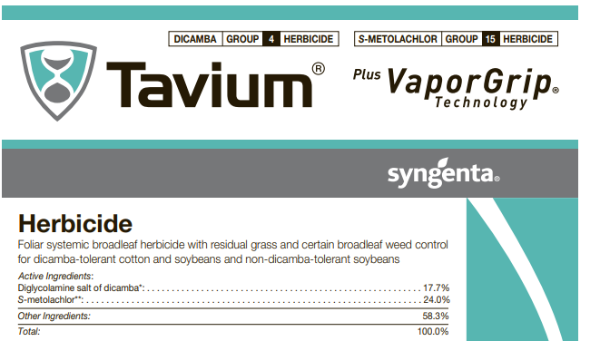
Tavium Registration for GA Cotton
XtendiMax + Dual Magnum
Overtop from full emergence through 6 lf cotton or 60 days after planting; whichever most restrictive.
Must have license to cover dicamba application.
Applicator must have attended UPW.

Slide 9
List Your Most Challenging Pests
Response | Times provided | Points by ranking*
Palmer amaranth (pigweed) | 1773 | 4983
Morningglory | 238 | 572
White flies | 155 | 318
Dayflower (spiderwort) | 131 | 254
Sicklepod | 113 | 223
Stink bug | 105 | 226
White mold | 61 | 95
Nutsedge | 48 | 82
Nematodes | 47 | 94
Annual grasses | 41 | 74
*Points were determined by giving 3 points for 1st choice of importance, 2 points for 2nd choice, and 1 point for 3rd choice. All locations – 1737 growers participated

Slide 10
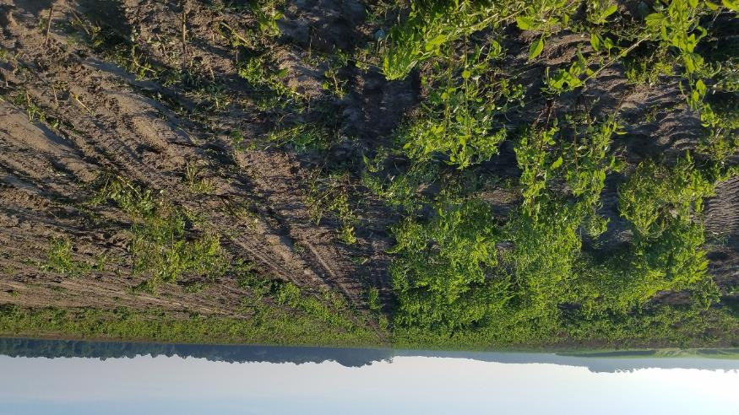
Cotton Management Program
Pigweed free at planting
Two effective residual herbicides PRE
Sequential POST applications
Layby with directed/hooded applic

Slide 11
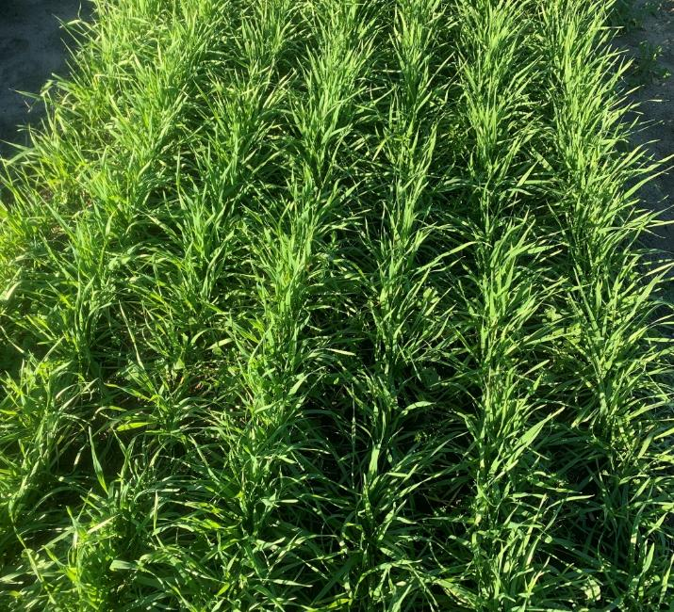
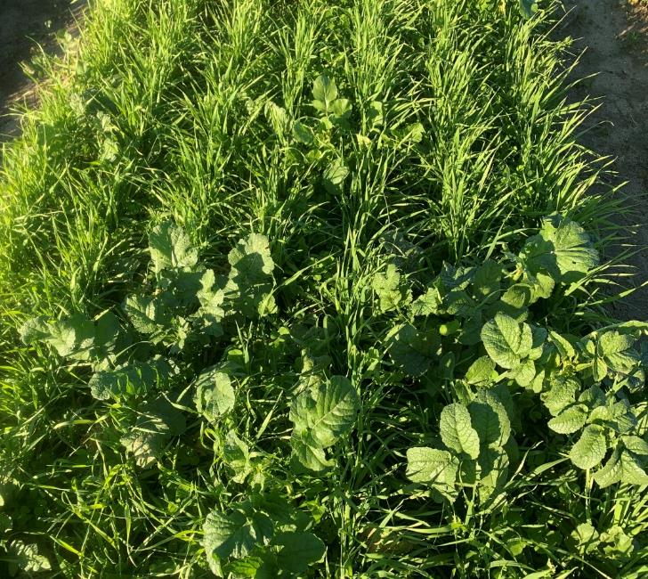
Killing emerged weeds immediately prior to planting vs immediately after planting.
Roundup applied 4 hours before planting.
Roundup applied 1 hour after planting.

Slide 12
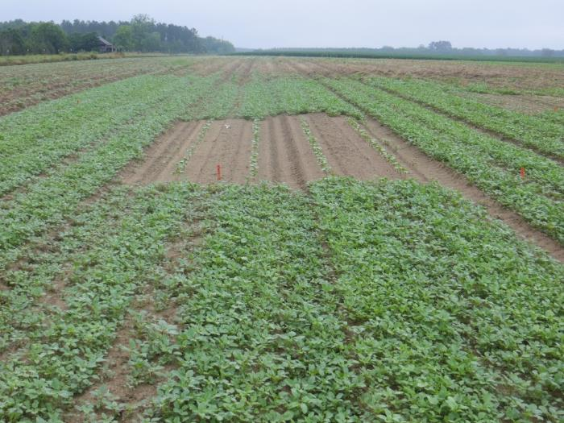
Cotton Management Program
Pigweed free at planting
Two effective residual herbicides PRE
Sequential POST applications
Layby with directed/hooded applic

Slide 13
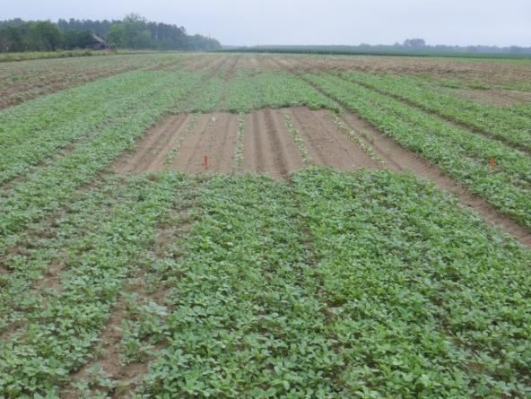
Number of emerged Palmer amaranth/A at 21 d.
55,510
ab
39,650 bc
26,840 c
4270 c
4575 c
2440 c
Reflex
16 oz
Direx
16 oz
Warrant
48 oz
Reflex
12 oz
+
Direx
12 oz
Reflex
12 oz
+
Warrant
32 oz
Direx
12 oz
+
Warrant
40 oz
The non-treated control consisted of 1,464,000 per acre; LSD 21 K;

Slide 14
Number of emerged Palmer amaranth/A at POST 1.
1,961,175
A
If 1 in 1,000,000,000 is resistant you have one on about every 500 acres
480,869
B
3717
C
1,524
C
Conventional
Rye Cover
Conventional
+
PRE
Rye Cover
+
PRE
Reflex 12 oz/A + Warrant 2 pt/A PRE. 4 locations.

Slide 15
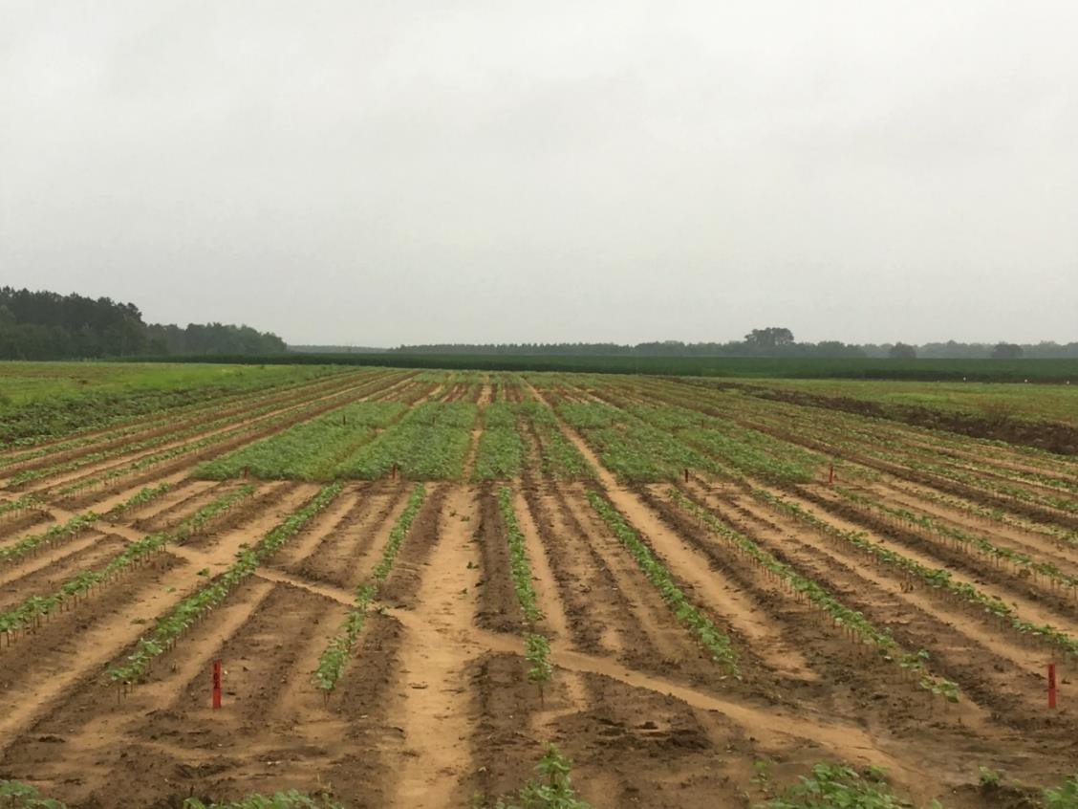
Weed Management System Influences Plant Bug Population. Ideal, GA.*
Weedy – up to 10X increase in plant bug population
Weed-free
Notes:
Since Palmer amaranth is an attractive host to TPB, we wanted to look at the influence of weed management system on the occurrence of damaged terminals. Whole-plots were blocked either weedy or weed-free to account for small plot size. It is important to note that weedy plots were maintained weedy until ~30 DAP, after which weeds were oversprayed with glufosinate, and the entire field remained weed-free throughout the remainder of the season.

Slide 16
Damaged Terminals vs Weed Management
System. Ideal, GA.
2017
2018
45
40
35
30
25
20
15
10
5
0
45
40
35
30
25
20
15
10
5
0
Damaged Terminals (%)
Damaged Terminals (%)
15
B
9
B
Weed-free
Weedy
Weed-free
Weedy
Weed Management System

Slide 17
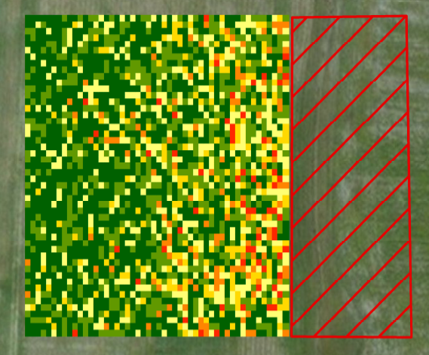
Palmer amaranth Adjacent to Cotton Influences Damage from Tarnished Plant Bug.
0/5 plants
1/5 plants
2/5 plants
3/5 plants
Palmer amaranth
4/5 plants
5/5 plants
144 ft.
0

Slide 18
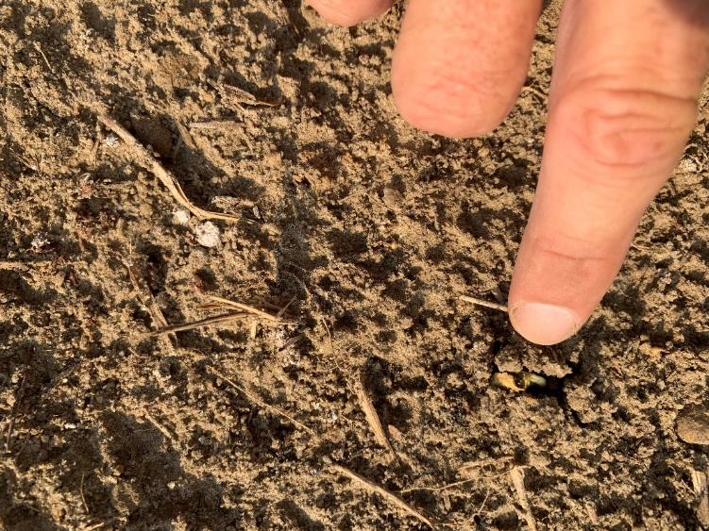
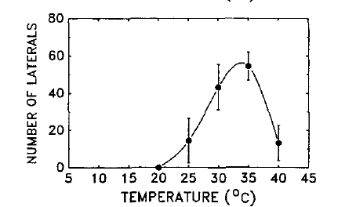
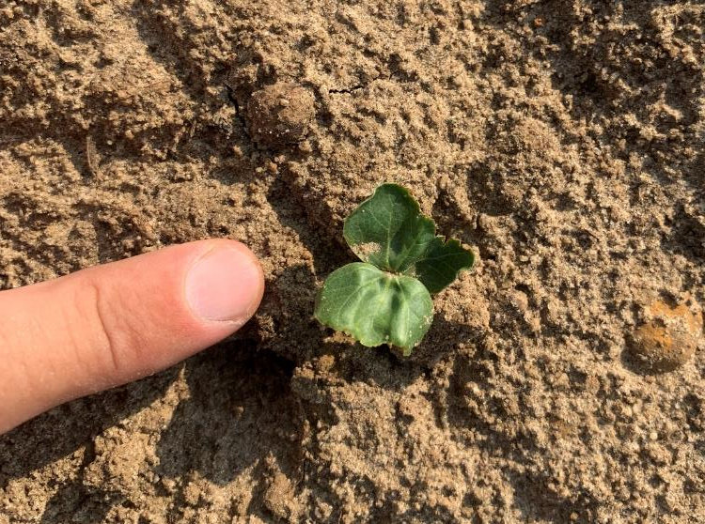
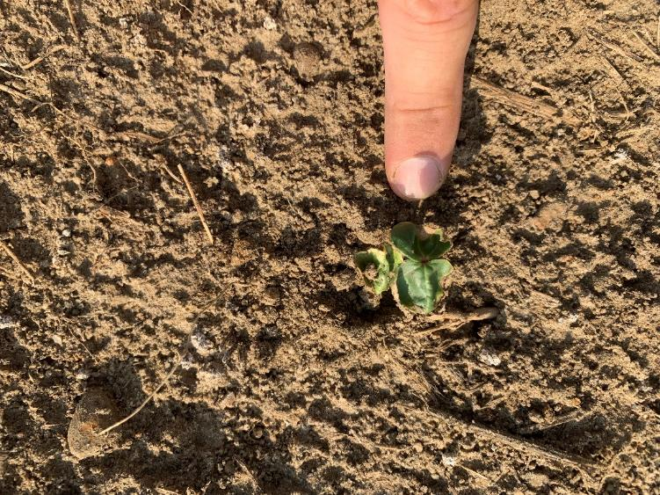
93 F
104 F

Slide 19
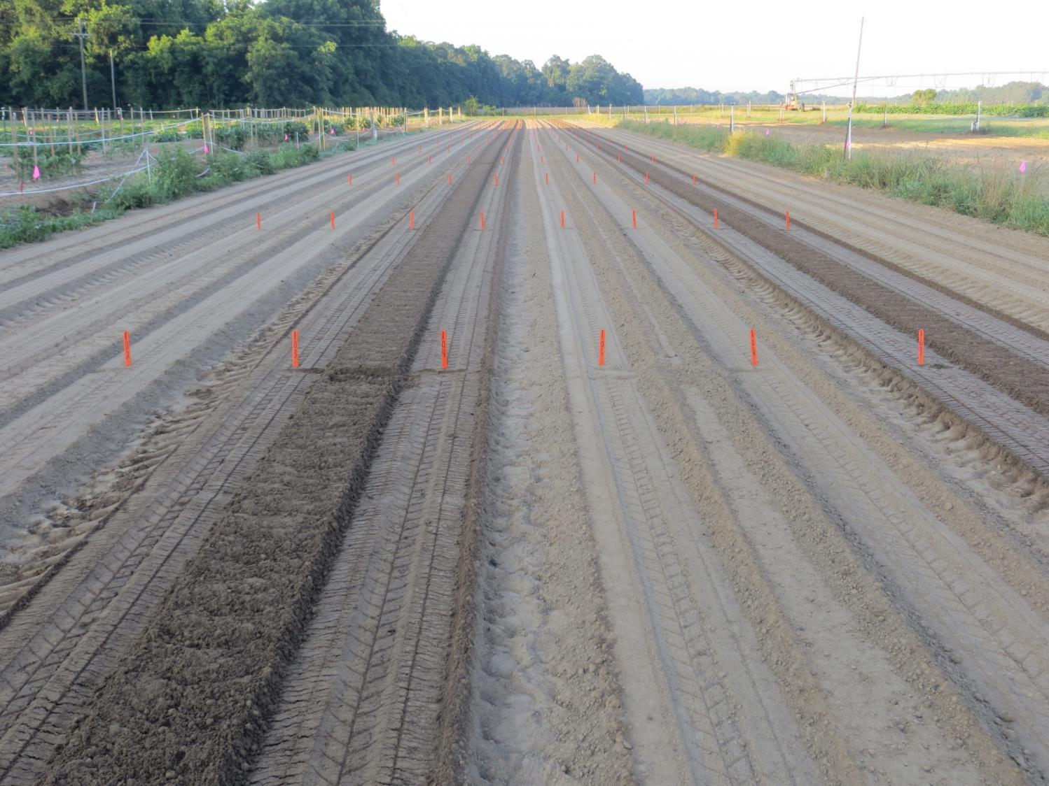
Influence of seed depth and moisture at planting.
0.35” deep
moist
0.7” deep
moist
0.35” deep
Very dry
0.7” deep
Very dry

Slide 20
Influence of seed depth and moisture at planting.
Reflex 16 oz/A
7%
7%
27%
36%
0.35” deep
moist
0.7” deep
moist
0.35” deep
Very dry
0.7” deep
Very dry

Slide 21
Influence of seed depth and moisture at planting.
Warrant 3 pt/A
4%
4%
8%
16%
0.35” deep
moist
0.7” deep
moist
0.35” deep
Very dry
0.7” deep
Very dry

Slide 22
Influence of seed depth and moisture at planting.
Direx 16 oz/A
0%
0%
3%
6%
0.35” deep
moist
0.7” deep
moist
0.35” deep
Very dry
0.7” deep
Very dry

Slide 23
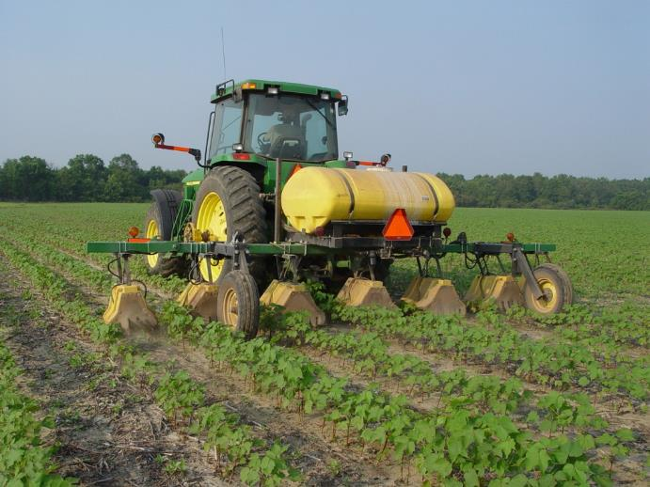
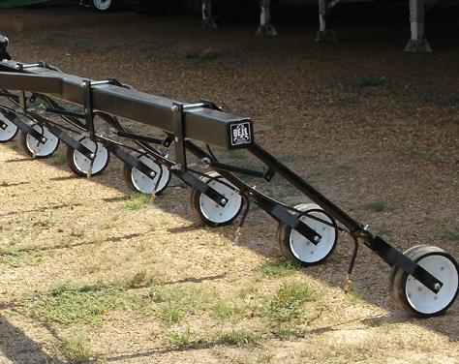
Cotton Management Program
Pigweed free at planting
Two effective residual herbicides PRE
Sequential POST applications
Layby with directed/hooded applic

Slide 24

Interval Between Liberty Applications Influences Palmer Control at Harvest.*
99 a
99 a
98 a
98 a
85 b
82 b
65 c
%
Labeled
Labeled
Labeled
No POST 2
1
3
5
7
10
14
Day interval between Liberty applications
*Data pooled over 3 locations from TyTy GA and over herbicide option. Palmer 6-8” at time of initial Liberty application.

Slide 25
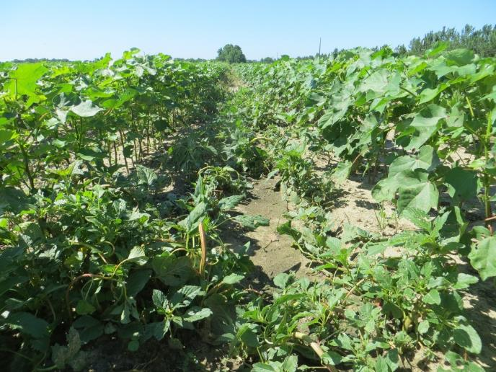
Cotton Management Program
Pigweed free at planting
Two effective residual herbicides PRE
Sequential POST applications
Layby with directed/hooded applic

Slide 26
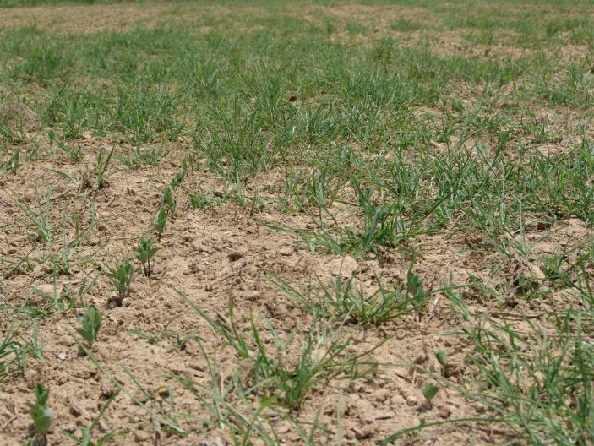
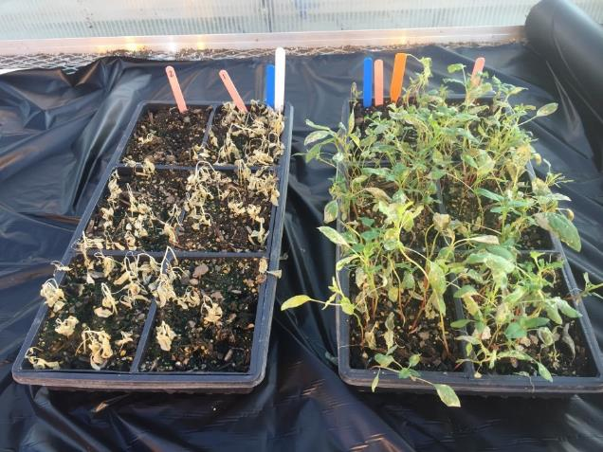
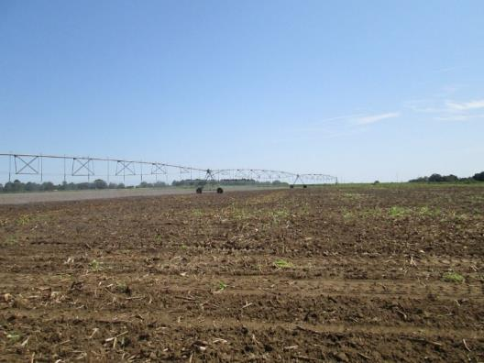
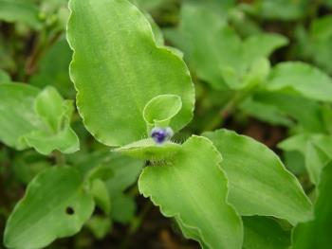

Hot Topics – 2019 - Review

Slide 27
Palmer 5” Response to Herbicides As Influenced by Varying Moisture Stress
90
81
55
30
Drought Stress
Stress removed 8 hr earlier
Drought Stress
Stress removed 8 hr earlier
RU + XtendiMax
Liberty
DAT = 11. LSD 14. C44-19. Liberty and PowerMax II = 32 oz/A; XtendiMax = 22 oz/A.

Slide 28


Grass Complaints From Roundup + Dicamba Continue
Steckel 2012

Slide 29
Grass Complaints From Roundup + Dicamba Continue
START WITH THE CORRECT PRE!!!!!
No less than 32 oz/A PowerMax II or labeled alternative equivalent
Less than 4” grass; goosegrass less than 2”
Environmental conditions huge impact
Sequential grass treatment may be needed
Steckel 2012

Slide 30

Warrant PRE
Dual/Warrant
2,4-D excellent
Dicamba – twice
Liberty – no good

Slide 31
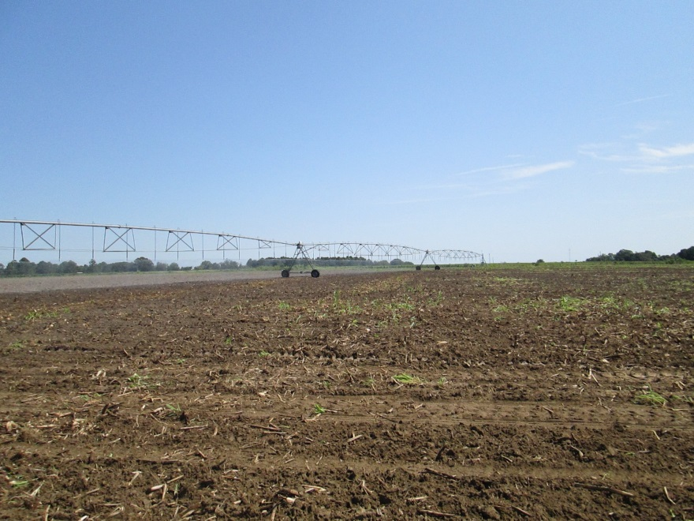
Currently, greatest concern with dicamba technology is volatility!
Anything new?

Slide 32
Irrigation Influences Volatility! Tunnels, 2019.
% soybean damage from volatility
%
35 a
30 a
7 b
0 c
No Irrigation
0.1”
Irrigation
0.35”
Irrigation
0.5” Irrigation
*RU PMAX + XtendiMax 3X. Need 4 hr of drying time.

Slide 33
FAR FROM BULLET PROOF!
Volatility can occur before water gets there!
Soil type likely influences result.
All acres are not irrigated….many are!
Walk slowly – don’t get cocky!

Slide 34

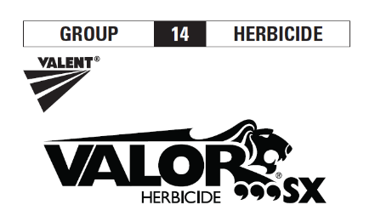


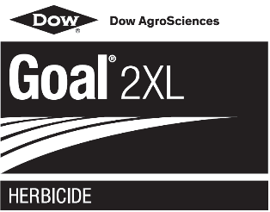


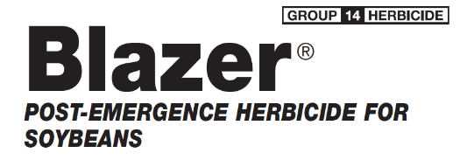

PPO Resistance Will Be Devastating

Slide 35

PALMER Amaranth Resistant to PPO Herbicides
Reflex 96 oz/A + NIS; Palmer 2”
Sensitive
Problem site

Slide 36
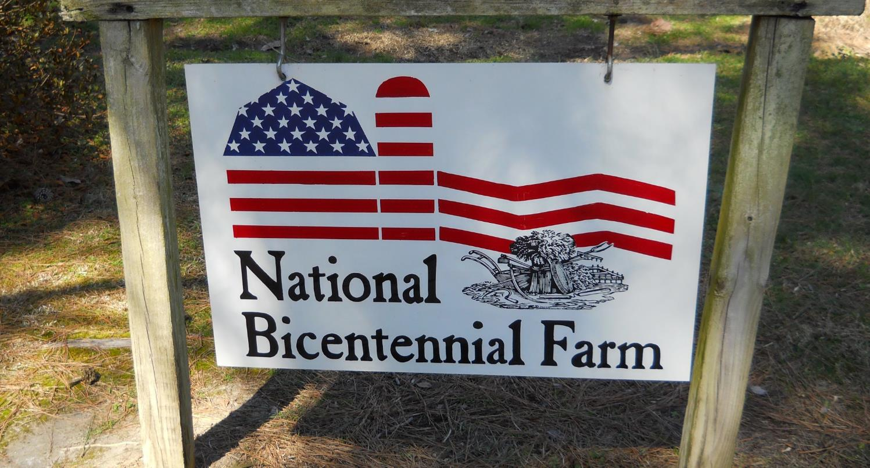
Questions?

